Slide 1
GASB 68 for cost sharing employers of the ASSESSORS’ RETIREMENT FUND
Presented by:
G.S. Curran & Co.

Slide 2
Table of contents
Background
Collective Net Pension Liability
Discount Rate
Employer’s Proportion
Pension Expense

Slide 3
background
Assessors’ Retirement Fund: a cost sharing multiple-employer defined benefit pension plan
64 Participating employers
No special funding situations
GASB 68 now requires that each employer recognize a liability for their proportion of the “collective net pension liability”
Pension expense and deferred outflows and deferred inflows of resources related to pensions should also be recognized

Slide 4
Collective net pension liability
Net Pension Liability = Total Pension Liability – Fiduciary Net Position
Total Pension Liability ($349,004,741 as of September 30, 2014)
Based on the individual Entry Age Normal actuarial cost method to attribute the actuarial present value of projected benefit payments
Measured as of the most recent date of the actuarial funding valuation (Sept. 30)
Uses same assumptions as funding valuation, except for the discount rate
Fiduciary Net Position ($314,045,097 as of September 30, 2014)
Market value of assets as of the end of the most recent fiscal year (Sept. 30)
Similar to unfunded accrued liability, but much more volatile because of volatility of assets
Could be Net Pension “Asset” if assets exceed liabilities
NPL = $34,959,644 as of September 30, 2014

Slide 5
Discount rate
GASB 68 requires that the liabilities be calculated based on a discount rate that reflects the long-term expected rate of return on investments and a municipal bond rate
Municipal bond rate is only used if projected net position is at any point insufficient to make projected benefit payments
100-year cash flow projections of benefit payments and assets to determine if there is a “crossover”
If a crossover exists, then the long term rate is blended with the municipal bond rate to create a new discount rate

Slide 6
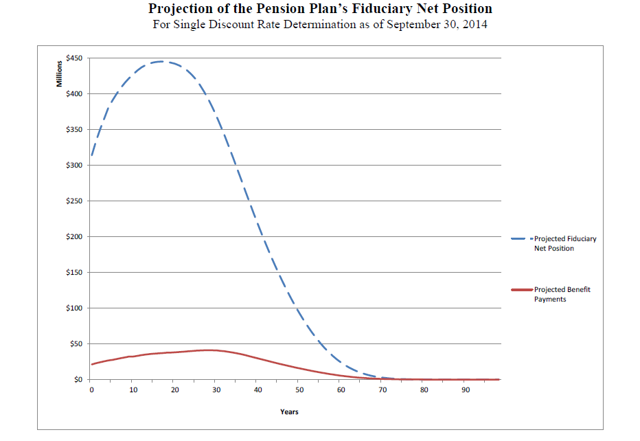

Slide 7
Discount rate
Because Louisiana requires actuarial funding of systems, we don’t project that there will ever be a crossover
Board selected long-term rate of return equal to funding rate
Discount Rate for 2014 = 7.25%

Slide 8
Employer’s proportion
Proportion of employer’s projected long-term contribution effort to the total projected long-term contribution effort of all employers and all “nonemployer contributing entities”
Nonemployer contributing entity: ad-valorem, revenue sharing, and insurance premium taxes
Total contribution effort of all employers: $2,810,747 for fiscal 2015
Employer’s projected long-term contribution effort:
Calculated in same manner as actuarially required contribution for the system in the funding valuation for the most recent fiscal year, but on an employer basis
Dollar amount = employer’s projected payroll × recommended contribution rate for that fiscal year
This proportion is multiplied by the collective Net Pension Liability to determine the employer’s proportionate share of Net Pension Liability

Slide 9
Pension expense
Elements of an employer’s pension expense:
Employer’s proportion of the fund’s collective pension expense
Employer’s proportion of the collective deferred inflows and outflows
Amortization of net change in proportions
Amortization of difference in contributions actually paid by employer and the employer’s proportion of total contributions to the system (including nonemployer contributing entities)
Collective pension expense = the change in the collective Net Pension Liability:
Service cost
Interest cost
Amortizations of gains and losses due to benefit changes, liability experience, assumption changes, investment experience
Member contributions
Projected earnings on pension plan investments
Administrative expenses

Slide 10
Pension expense
Assessors’ Collective Pension for 2014
Element of Pension Expense | Amount
Service Cost | $8,445,473
Interest on Total Pension Liability | 24,678,438
Changes in Benefit Terms (COLA) | 1,896,120
Amortization of Experience (Gain)/Loss | (886,035)
Amortization of Assumption (Gain)/Loss | 1,367,693
Member Contributions | (3,292,049)
Projected Earnings on Investments | (21,524,702)
Amortization of Investment (Gain)/Loss | (893,727)
Administrative Expenses | 315,204
Total Collective Pension Expense | $10,106,415

Slide 11
Pension expense
GASB 68 allows system to defer a part of the gains and losses due to experience, assumption changes and investments
Experience and assumption gains and losses amortized over expected remaining service lives (ERSL) of all members (including inactives)
Total future service of active employees divided by number of active and inactive participants as of the beginning of the measurement period
Total future service = 7,741
Number of active and inactive participants = 1,358
Average = 5.70
Rounded number (6) is ERSL

Slide 12
Pension expense
Investment gains and losses amortized over 5 years
These amortizations get recognized in collective pension expense
Amounts not recognized get added to deferred inflows or outflows
Benefit changes are recognized in pension expense immediately
Contributions from employers and non-employer contributing entities are not recognized in expense, but shown as revenue

Slide 13
Questions?

